Slide 1
Lecture 4
Example scenario

Slide 2
Lecture 4 outline
The importance of data (~10mins)
Emergencies (~10mins)
Emergency example (~10mins)
Data gathering vs data generating: experiments (~10mins)
Data gathering vs data generating: real-world sources (~10mins)

Slide 3
In the Yorkshire, UK, 2018, there was a record-breaking set of wildfires that led to the declaration of a major incident
On 24th June 2018 fire broke out at Saddleworth Moor, and over the next few days covered more than 2000 acres and required the evacuation of ~150 people from their homes in Greater Manchester.
Changing winds meant that there was significant uncertainty over the direction of the fire,
There is a complex level of decision making when considering evacuating people. It costs money, takes time, and inconveniences people.
But there are uncertainties here: how long will it take? How much will it cost? So the question is: at what point do you take the decision to force an evacuation of these people?

Slide 4
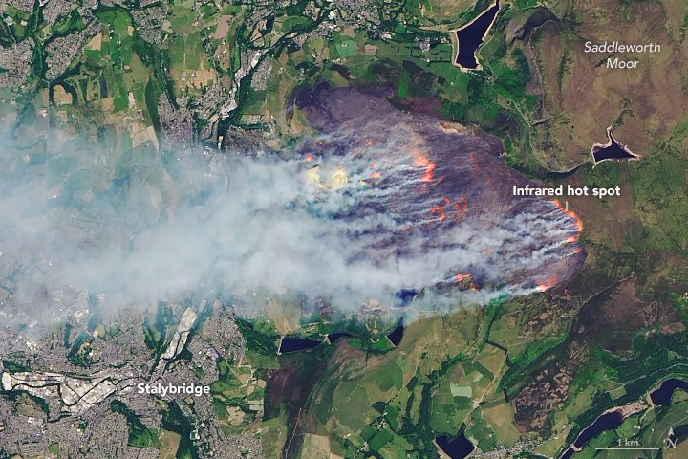
Saddlesworth Moor, Yorkshire, 2018

Slide 5
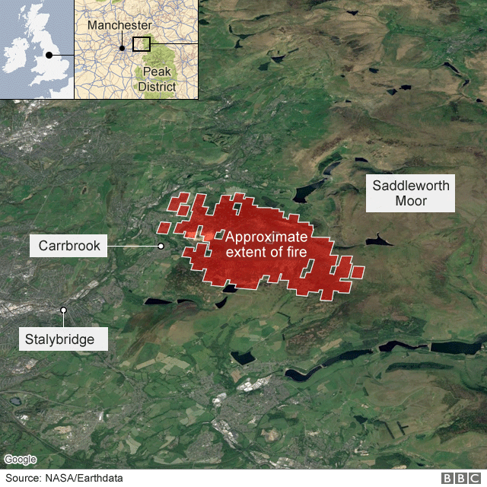
At what point do you evacuate Carrbrook?
Or Stalybridge?
How long will it take?

Slide 6
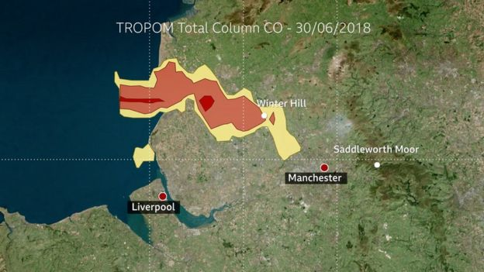
Do you have to evacuate people from the smoke plume?
How long will that take?

Slide 7
Pedestrian dynamics can help by modelling exactly how long it will take to evacuate people. Or by assessing the best way of evacuating people. It can do this in real time (to an extent), and can accommodate different inputs (for example, whether people need specialist vehicles, or whether they can evacuate by themselves). They can then provide this information to the people that decide whether to evacuate a town, reducing the risk and uncertainty around this decision.
Further to this, there are also future implications. Autonomous vehicles will be able to pick up stranded people, with minimal risk.

